Slide 1
HSV (Hue, Saturation, Value) 정보 추출하기
Sang Yup Lee

Slide 2

Color (색 또는 색상)
What is color?
색의 전체적인 개념으로, 색조, 채도, 명도를 포함
Color is a combination of three key aspects, hue, saturation, and value

Slide 3
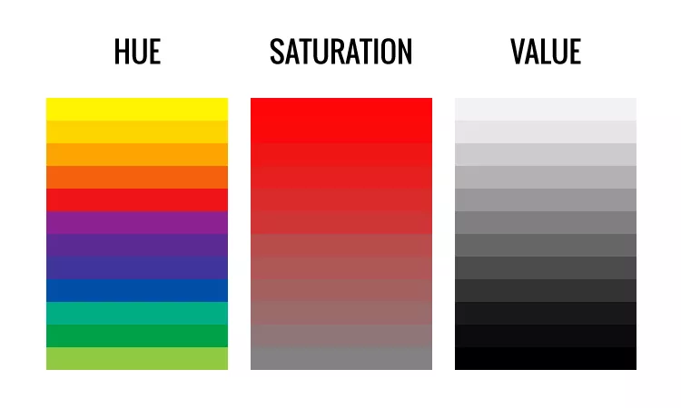
HSV
HSV

Slide 4
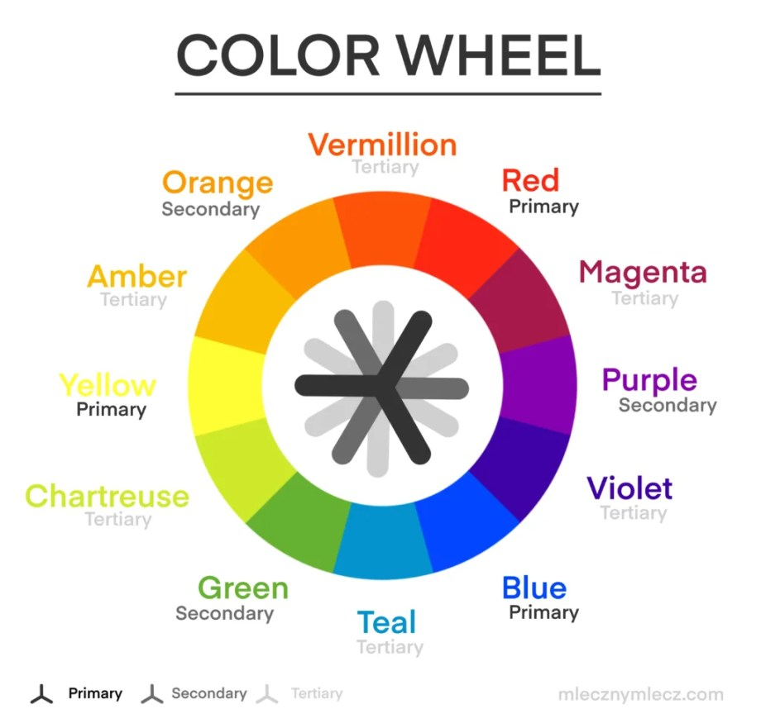
Hue (색조)
What is Hue?
Hue is the color attribute that determines the name of a color, such as red, green, blue, yellow, or purple.
색상에서 특정 색의 종류를 나타내는 속성
A color wheel
It is a circular diagram that represents the relationships between different hues.
Python
pip install opencv-python
Extract_color_info.ipynb
Extract_dominant_color_info.ipynb

Slide 5

Saturation (채도)
What is Saturation?
Saturation refers to the intensity or purity of a color. It determines how vivid, intense, or "pure" a color appears.
채도는 색상의 선명도 또는 강렬함을 나타내며, 색이 얼마나 생생하고 강한지, 또는 얼마나 흐릿하고 회색에 가까운지를 결정하는 속성
Python
calculate_saturation.ipynb

Slide 6

Value (명도)
What is Value?
Value determines how light or dark a color is.
Python
calculate_value.ipynb

